Slide 1
Multiplication Table Generator
TEAM NAME :- SIC-25-26-Team142

Slide 2
Multiplication Table Generator
About our Team
TEAM NAME :- SIC-25-26- Team142
PROJECT TITLE :- Multiplication Table Generator using Python Tkinterultiplication Table Gelication Tablet
TEAM MEMBERS & ROLES
TEAM LEADER :- Ms. Deepali Sandhu
MODEL BUIDER :- Mr. Shivansh Sapehia
DATA LEAD :- Mr.Varun Singh Pathania
RESEARCH & TESTING :- Ms. Diksha Kumari
PRESENTATION & DEMO :- Ms. Gargi Sharma
COURSE :- SIC Coding & Programming
COLLEGE & BATCH CODE :- Rayat Bahra University & Batch-2(25038)
Multiplication Table Generator

Slide 3
Multiplication Table Generator
Problem Statement
What real-world problem are you solving?
Students often need to repeatedly write multiplication tables while learning mathematics. This manual process takes time and may lead to mistakes. The Multiplication Table Generator solves this by automatically producing tables for any input number through a simple graphical interface, saving effort and improving accuracy. It is especially useful for school students and beginners learning programming conceptst.
Who is affected by this problem?
Primary school students learning tables, teachers demonstrating examples in class, and beginner programmers practicing Python GUI development benefit from this solution.
Multiplication tables are fundamental in mathematics education.

Slide 4
Multiplication Table Generator
Objective of the Project
Main goals of the solution
Provide a simple interface to enter a number
Automatically generate multiplication tables.
Reduce calculation errors.
Demonstrate use of GUI programming concepts in Python.
Expected outcome (what will the system do?)
The application allows the user to input a number and instantly displays its multiplication table within the GUI window, improving usability and learning efficiency

Slide 5
Multiplication Table Generator
Proposed Solution
Solution approach in simple language
The system is built using Python with Tkinter to create the graphical interface. The user inputs a number, presses a button, and the program calculates results using loops and displays them inside a text area widget.We build a web-based system where all student, teacher, and academic data is stored in one place . Admin, teachers, and students log in and use their dashboards to manage attendance, marks, and records easily and securely.
Unique features
Interactive GUI built with Tkinter
Instant table generation
Error handling for invalid input
Educational and easy-to-use interface

Slide 6
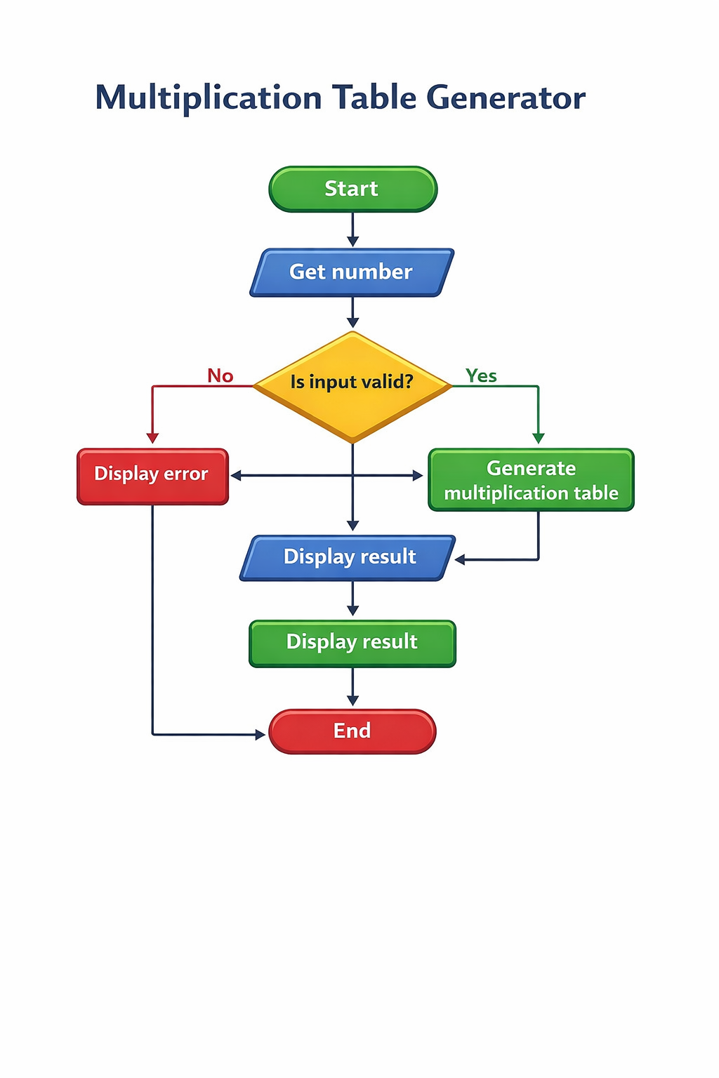
Multiplication Table Generator
System Architecture / Flow Diagram

Slide 7
Multiplication Table Generator
Tools, Technologies & Libraries
1-Visual Studio Code (VS Code) – Code editor
2-Python Interpreter – To run program
3-Terminal / Command Prompt – For execution
4-GitHub – Version control (optional, if you uploaded project
🔹 Operating System
Windows / Linux / macOS
Libraries Used : - 1. Tkinter -For creating graphical user interface (GUI)
2-Random (built-in Python module) -Used to generate random positions and symbols for background design
3-Custom Module (logic.py) -Contains backend logic for generating multiplication table

Slide 8
Student Management System
Dataset Description (If applicable)
Dataset size
This project does not use any external or pre-collected dataset.
All data is generated dynamically based on the number entered by the user at runtime.Therefore, the dataset size is variable and depends on the range of multiplication values produced (e.g., 10 rows for a table from 1ā€“10)
Data cleaning summary
Minimal data cleaning is required because no stored dataset exists.
However, basic validation is performed:
Checking that input is numeric
Handling empty or invalid input
Preventing program crashes due to incorrect values

Slide 9
Multiplication Table Generator
Project Screenshots / Project Designs
Coding Logic: The application is designed using Python and Tkinter (GUI library). It follows an event-driven approach where the user interacts with graphical components.
Algorithm Used :
1. Take number input from user.
2. Validate input.
3. Use loop to compute multiples.
4. Display results in GUI output area.

Slide 10
Multiplication Table Generator
Results & Performance
Result / Final Outcome
A functional GUI application that generates multiplication tables quickly and accurately. It demonstrates Python basics, event-driven programming, and user interface design.
Key findings
The system reduces manual work, improves accuracy, and makes academic data easy to access.
Challenges Faced
Handling invalid inputs, GUI layout arrangement, and debugging widget interaction issues.t.
Future Scope
Add options to print/save tables, support range of numbers, include themes, or export output to PDF.
Features to be added
Online fee payment, timetable management, and report export (PDF/Excel).
Scaling or deployment plans
Deploy the system on a cloud server and use a stronger database for more users and data.

Slide 11

Thank You
Open for questions
Samsung Innovation Campus

